Slide 1
Is Transfer Learning Possible in Reinforcement Learning?
Scaling Difficulty on a Trained Agent in Super Smash

Slide 2
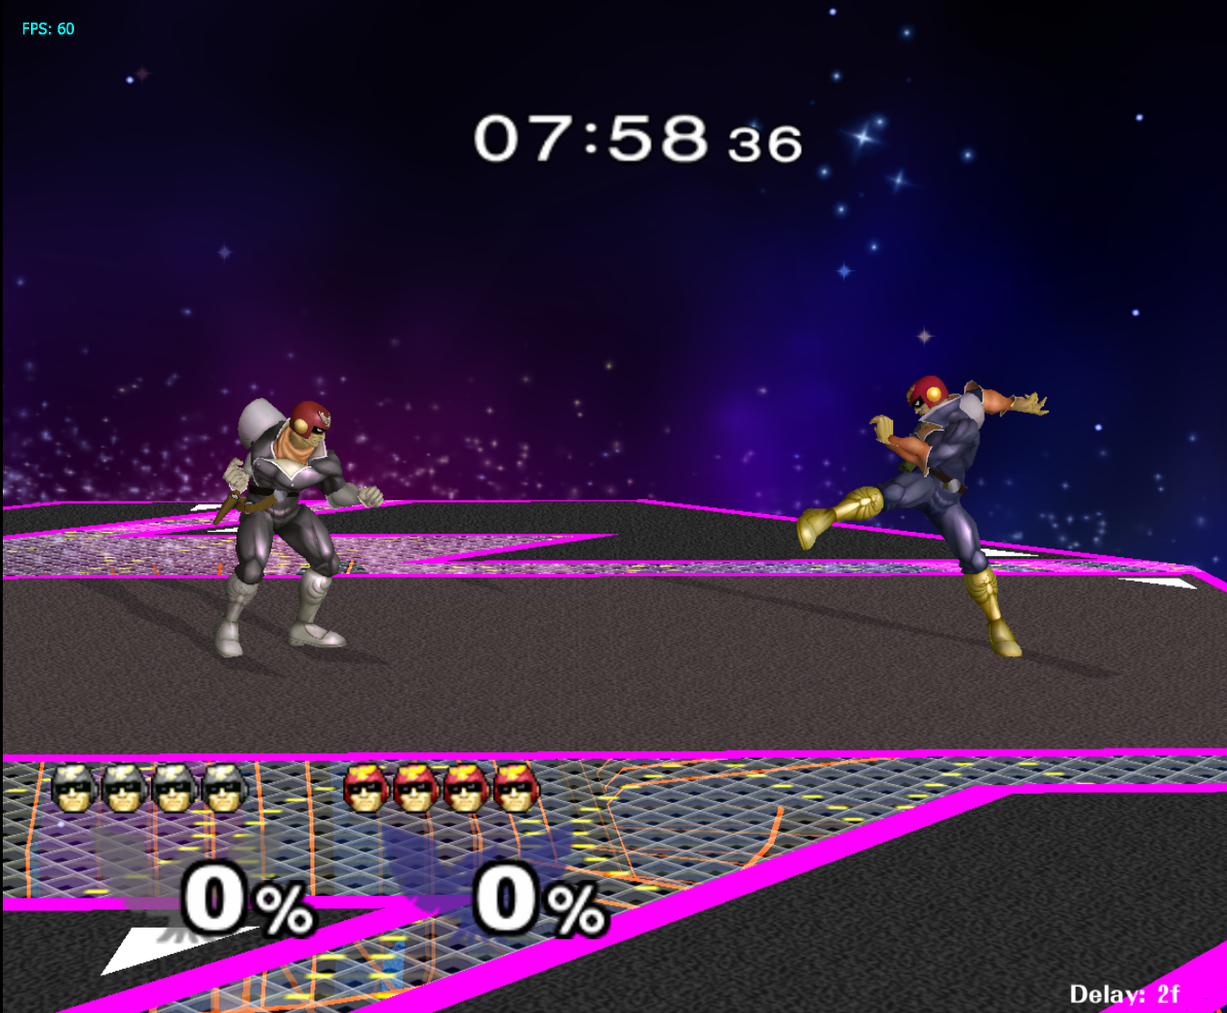
The What and the Why
Super Smash RL Agent
Deep Q Learning in a complex environment
Transfer learning applied to Reinforcement Learning
  Increased difficulty against trained networks
Notes:
Add graphic of environment

Slide 3
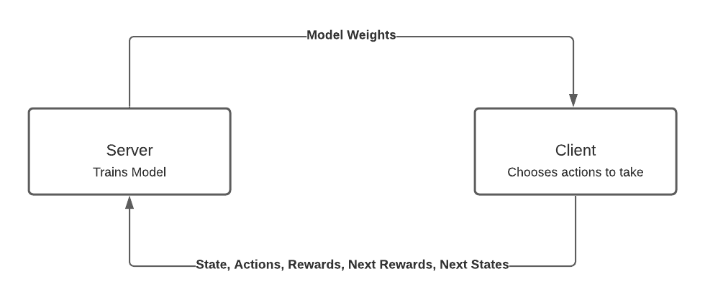
Server-Client Model
Django Server
  Trains model
Client
  Runs the environment
  Any Local Computer
  Scalable

Slide 4
State Representation and Reward
Reward Structure
  +200 for kill, -200 for death, +1 per damage percent, -1 per damage percent
State Representation
  Knows for the 2 bots the following:
    Lives, percentages, on the ground, off the stage, shield strength, x and y position, which direction it is facing, and its speeds in the x and y positions
  26 elements in total
  Then adds previous move to the end of the state representation as recommended by Chris
    56 total elements in each state (30 different actions)

Slide 5
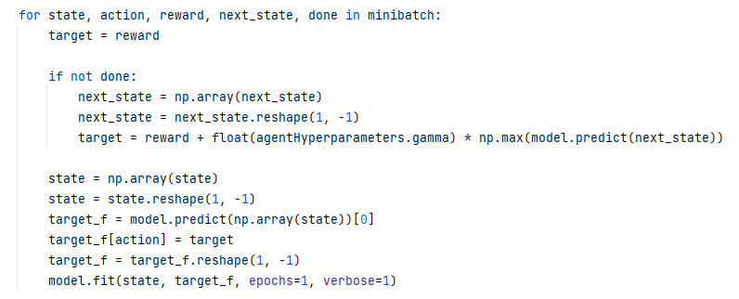
Learning Algorithm
Deep Q Learning
Trains against Level One AI
  Trains against more difficult AI afterwards
  “Transfer Learning”
Notes:
Image of Learn Function

Slide 6
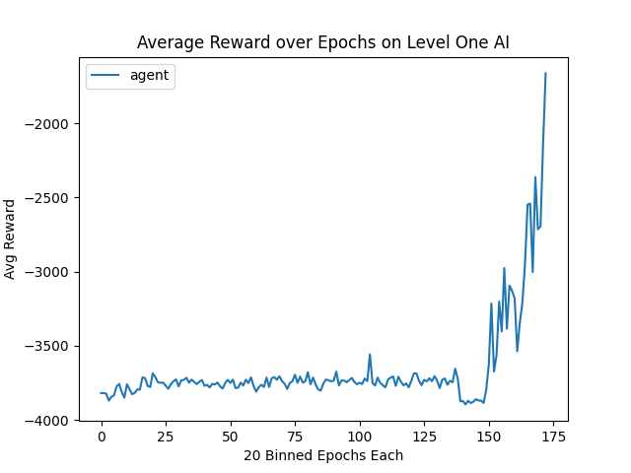
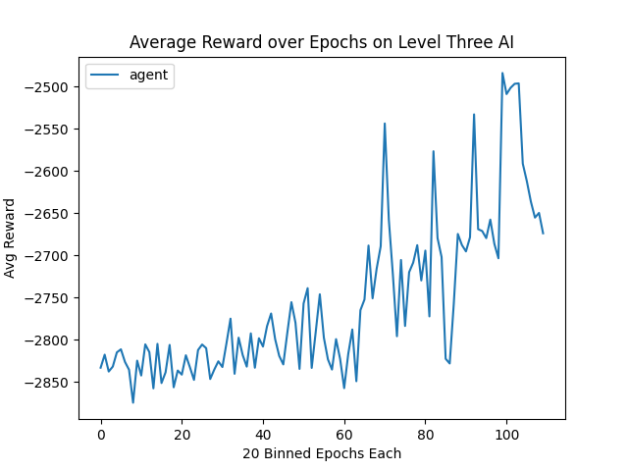
Results
First Trained to beat a Level One AI
  Required about 3500 epochs to begin to beat the AI
Even after 2000 epochs didn’t beat a Level Three AI using the weights from Level One
  Ran again, with deeper network
Notes:
Abuse of Level One AI

Slide 7

Results

Slide 8
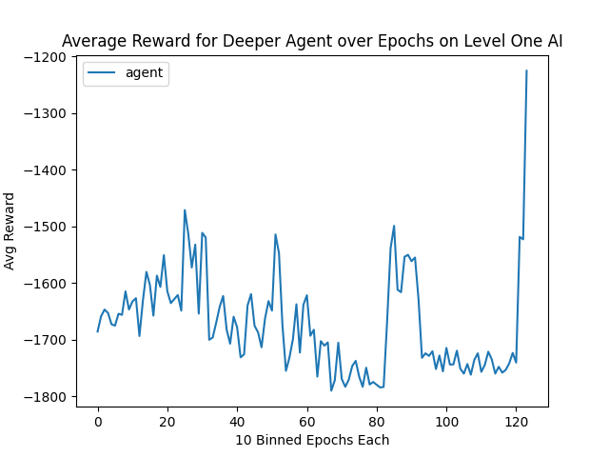
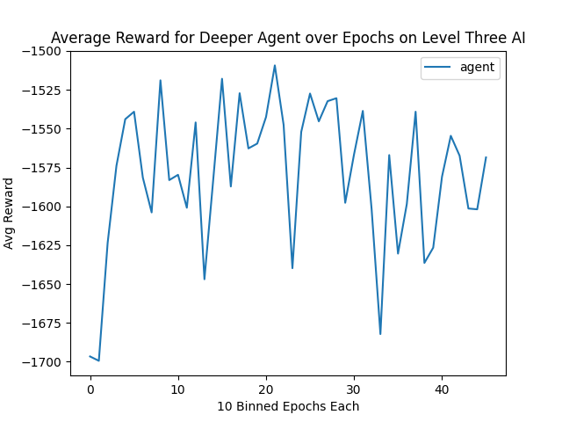
Results
Deeper Network Used
  5 Dense Layers instead of 3
Had to train much quicker because of time constraints
  Quick improvement, but not much from there

Slide 9
Results
Does well then turns around and kills itself everytime after

Slide 10
Summary
Hardly a difference in training agent to play against Level One/Level Three bot
  At least, so far
Does train enough to kill sometimes
  Tends to kill itself a lot
Uses same move over and over
  Good for level one bot, level three easily beat it
Potentially, slower scaling of difficulty
  Level one to Level three is a big jump
  Train against level two first might yield better results

Slide 11
Limitations and Future Work
Takes a really long time to train
  Complicated state space and large action space
Reward for particular moves used
Watch games of professionals and learn from them for a baseline
Implement an Actor Critic network or PPO instead of DeepQ for faster training
Scale Clients, have more running environments
  Parallel Training

